Slide 1

HANDLING CRISIS IN OUR SCHOOLS
MARISA VICERE, JANA MARIE FOUNDATION
EVELYN WALD, TIDES PROGRAM

Slide 2


In times of crisis people search for meaning. Meaning is strength. Our survival may depend on us seeking and finding it.
Viktor Frankl

Slide 3
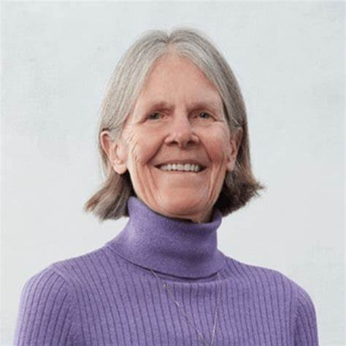
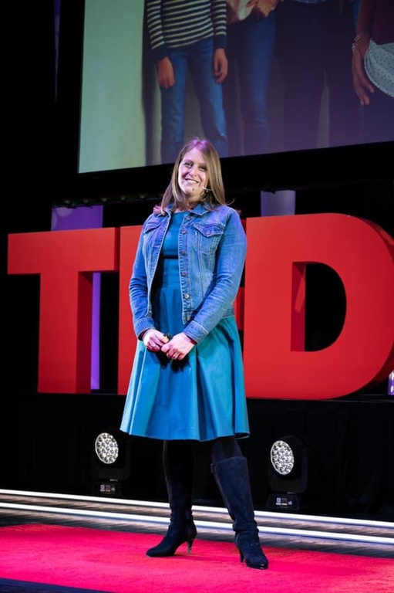


ABOUT US

Slide 4

WHEN A CRISIS OCCURS, WHAT COMES UP FOR YOU?
pair and share - be ready to report out, if comfortable

Slide 5

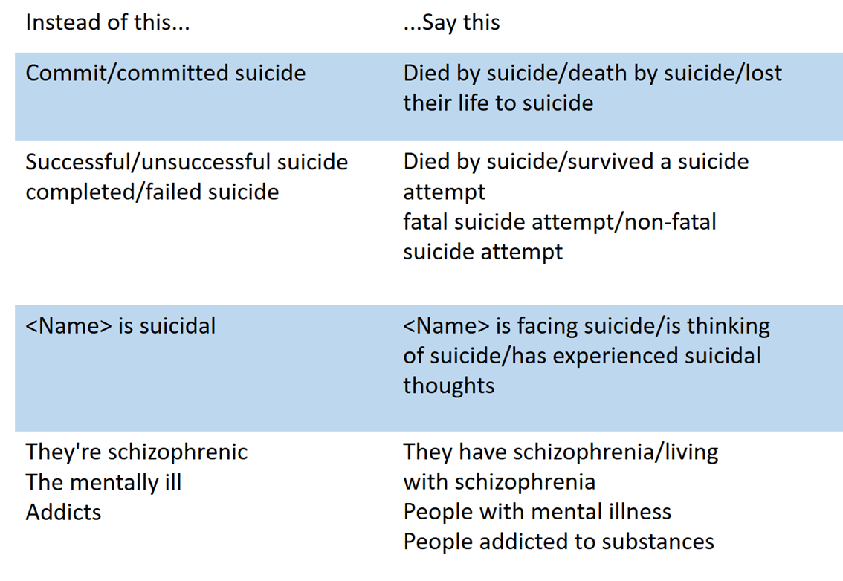

WORDS MATTER
how we talk about death, especially stigmatized deaths, matter!
passed away
died

Slide 6
OTHER POINTERS
  Work with the family to see what information they want to share
  Provide only the facts
  Provide resources to family - both school/organization and outside supports
  Be aware of the emotional response that happens after an event
  Know your policies
  Don’t be afraid to ask for support from professionals

Slide 7
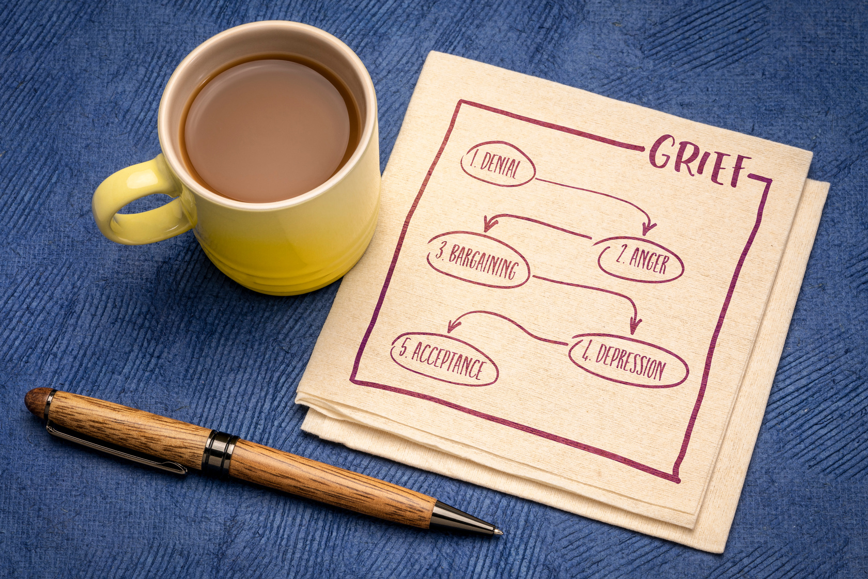

IMMEDIATE RESPONSE
Work with your flight team or the protocols you have in place already

Slide 8
RESPONDING TO A CRISIS
  Show up
  Share appreciation for showing up
  Listen
  Establish or discuss supports (strengths and resiliency)
  Ensure there will be another check in later in the week.
  Brief discussion of grief
  Students may think that grieving is a whole new set of skills
    What has helped you in the past during difficult times?
    What are some calming or coping strategies or adaptive skills that you have used in the past?

Slide 9
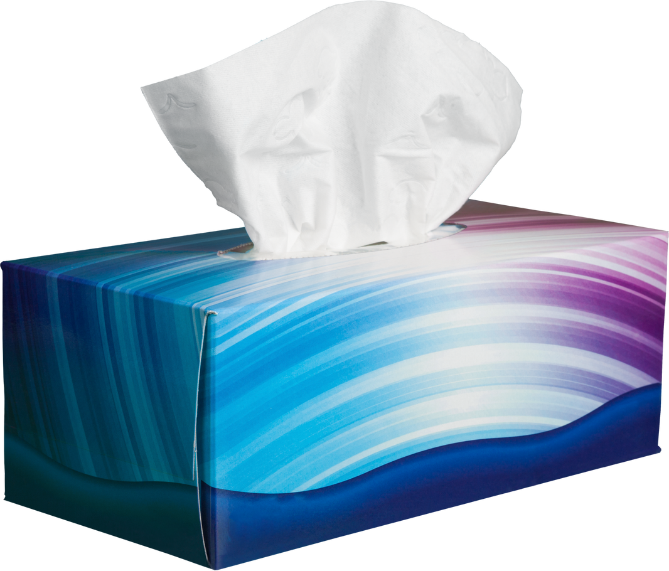



Staff with counselors, outside support staff, and other individuals.
Include a sign in sheet.
Allow educators and students to use the room, if needed.
SET UP A SUPPORT ROOM
Kleenex
Stress Relief Items
Resources
Snacks

Slide 10
· Please tell us a little about what you have been thinking, feeling, or experiencing since you heard the news?
· How did you hear the news?
· If you knew [name], please share something you would like to share about them.
· What has been the hardest thing for you?
· What are your needs or questions do you have right now?
· How can we support you in school in the upcoming weeks?
· Who are some support people in your life you can talk to about this?
· What has helped you in the past during difficult times?
· What are some calming or coping strategies or adaptive skills that you have used in the past?
QUESTION PROMPTS
Have some prompts ready, but be ready to listen and follow the lead of the student or individual you are talking to

Slide 11

MAKE A PLAN TO MOVE FORWARD
Routines are important for individuals who are grieving. We NEVER want to suggest someone has grieved long enough. Instead, we are making a plan together to provide support and to bring routine back into the person’s life.

Slide 12

BUT, HOW LONG
SHOULD WE OFFER
THESE SUPPORTS?

Slide 13


Slide 14

LONG TERM RESPONSE
be aware of things that could activate emotional responses

Slide 15
KEY CONSIDERATIONS
  KEEP SHOWING UP FOR STUDENTS AND TEACHERS WHO MAY BE EXPERIENCING DIFFICULT TIMES
  BE AWARE OF UPCOMING TRANSITIONS OR MILESTONES THAT COULD BE DIFFICULT
  ESTABLISH OR DISCUSS SUPPORTS (STRENGTHS AND RESILIENCY)
  REVISIT SUPPORT GROUPS OR OTHER SMALL GROUPS (RESILIENCY, ETC.) THAT MAY BE HELPFUL
  BE AWARE THAT GRIEF LOOKS DIFFERENT FOR EACH PERSON AND IT COMES AND GOES. DON’T MAKE ASSUMPTIONS
  BE AWARE OF DIFFERENT POLICIES YOU HAVE AND FOLLOW THEM

Slide 16

HOW CAN WE PROVIDE SPACE TO REMEMBER WHILE BEING CAREFUL TO NOT RETRAUMATIZE SOME INDIVIDUALS?

Slide 17


Slide 18
THANK YOU
FOR COMING

