Slide 1

Loss of Experience
Natalie Hernandez
Grief Matters Seminar

Slide 2

Objectives
Participants will discuss the common factors associated with loss of experience and compare/contrast these with grief due to death of an important other.
Attendees will review dialectics related to loss and learn how a wise mind paradigm permits holding of opposite views.
  This approach is helpful to traverse unmet, highly anticipated experiences.

Slide 3

Agenda
Introduction
Intentions
Orienting
Your why
Our collective why

Slide 4
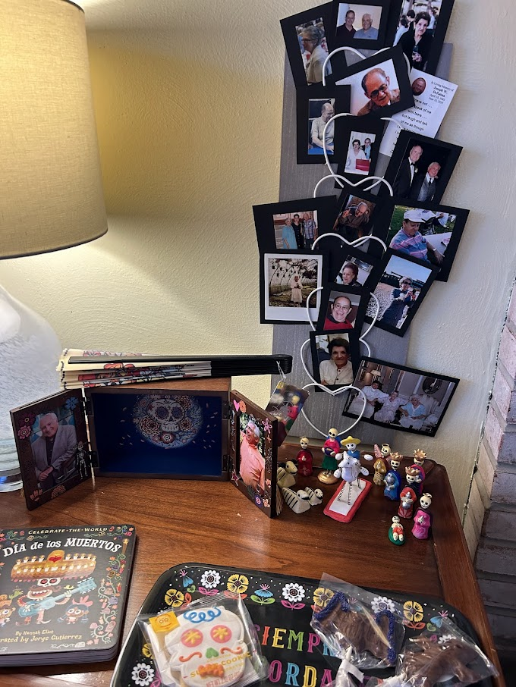

Dia De Los Muertos

Slide 5

Redefining Loss
Chapter 1

Slide 6
Personal and Prevalent
Can you recall a time when an event or experience was unceremoniously removed from your calendar?
How did it come about?
What reaction did you have? How does it impact you now?

Slide 7

Psychiatrists Thomas Holmes and Richard Rahe did research that led to the development of the Holmes-Rahe Stress Scale. This details the 43 life events most liable to create grief feelings which can in turn cause health related concerns.

Slide 8
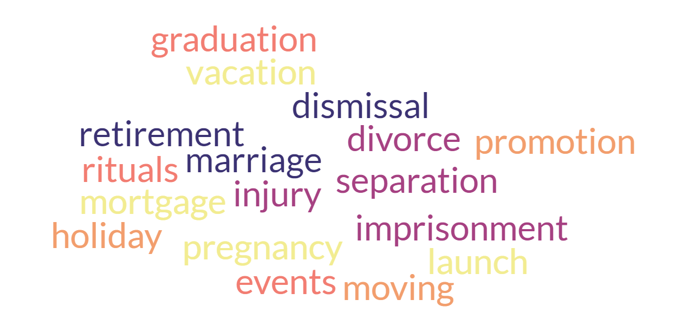

Slide 9
Symptoms of Grief
Emotions | Thoughts
Physical Health | Behaviors
Spiritual
Notes:
Grief looks different in everyone. Some symptoms are expected, anticipated, and easily recognizable. But many others can be surprising and confusing.
For emotions – almost every feeling is a possibility -numbness, shock, yearning, sadness, anger, guilt, anxiety, loneliness, helplessness, yearning, relief.
While we often think only of sadness, any emotion is possible and valid
Our thoughts and cognitions can also vary. – Denial, disbelief, confusion, preoccupation with the loss, forgetfulness, sense of "going crazy“.
Our grief can often manifest in physical symptoms – Dry mouth, tightness in throat, chest, fatigue, dizziness, shortness of breath, butterflies or emptiness in tummy, loss of energy, depersonalization.
After a loss our behaviors often change. You may notice yourself crying, sighing, sleeping or eating differently, forgetful, withdrawing from others, experiencing mood swings, feeling passive or overactive, or increasing substance use
Finally, you may notice a spiritual change. This is not necessarily tied to a particular religious faith.
You can question why you had to lose what you did, lose meaning or faith in the world, be angry with the divine, lose your religious faith, find increased comfort in religion, or feel alienated

Slide 10

The Path We Expect

Slide 11

Types of Grief and Loss
Loss due to death of a loved one is socially accepted and bereavement expected
Loss of experience is mostly invisible and not associated with:
  Any particular HR policies/procedures to support leave
  Less cards available to send to offer support
  Confusion about feelings/thoughts/behaviors
During Pandemic:
Large numbers of death.
Lack of loved ones during illness and death
Notes:
To understand how to cope with grief, we must first the different kinds of grief
Grief often occurs after the loss of life.
We typically expect grief during this time.
Our grief tends to be recognized by others, acknowledged, and understood
Though people may put a false time limit on how long they expect us to grieve
Bereavement occurs following a loss.
We engage in the internal experience of grief, and the external experience of mourning
Grief is an inward, emotion process.
Mourning is an outward expression of grief.

Slide 12
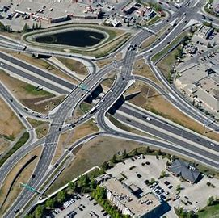
The Path We Must Take
Chapter 2

Slide 13
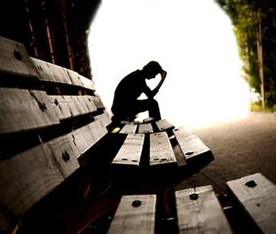
Loss of Experience
Experiential Loss:
  Loss of an experience, situation, or condition
  Examples:
    Loss of Safety & Security
    Loss of Traditions & Events
    Loss of Normalcy & Routine
  More abstract, so less recognized, acknowledged, or understood - just as critical to be processed
This Photo by Unknown Author is licensed under CC BY-SA-NC
Notes:
Because grief occurs for any type of loss, we experience it not just when we lose a person, but lose something else valuable to us
During uncertain times, we can lose our sense of safety, our routines, or can miss out on experiences like time spent with friends, important celebrations, and more.
Because these losses are less tangible, less socially accepted, they often are misunderstood and underappreciated
Yet the feelings of grief and need to mourn can be the same

Slide 14
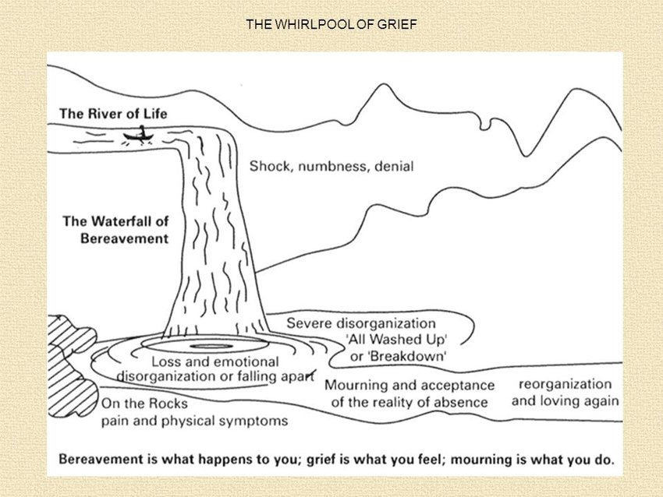
Dr. Richard Wilson

Slide 15




Anticipatory Grief
Expectation of any type of loss (e.g. empty nest)
Uncertainty, loss of control, feeling helpless
Tension between hope and letting go

Slide 16

Building the Wise Mind & Dialectic Understanding
Chapter 3

Slide 17
Reasonable Mind & Emotional Mind
Logical
Reason/Fact-Focused
Problem-Solving
Highly Verbal
Pragmatic
Feeling-Centered
May be Unreasonable
Irrational
Immediacy
Body-Centered

Slide 18
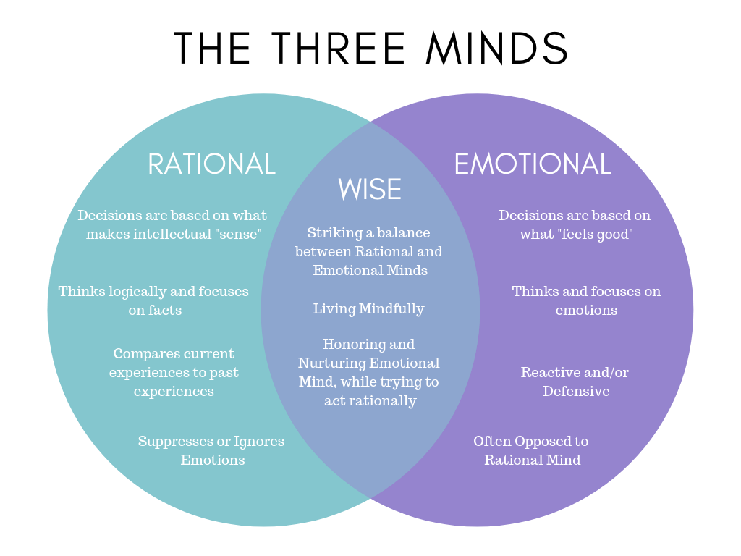
G

Slide 19

What Contributes to a Wise Mind?
Ideal vs Real
Flexibility
Curiosity
Non-Judgement
Creativity
Connection
Compassion

Slide 20




Increasing Awareness
Clarity
Capability
Connection
Consistency

Slide 21
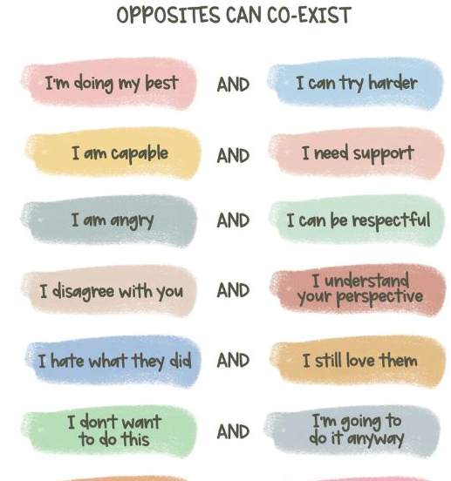
Dialectical Thinking
Wise Mind in Action

Slide 22


Slide 23
Shared Understanding
Dualistic Conversation
"We Are Wise"
There are two opinions, and one is correct
A successful negotiation is where both sides feel they lost
Advocating for "me" or "mine“
  This is the conversation when only rational mind and emotion mind are trying to speak with one another
Identify similarity in goals
  Where does my rational mind (I need to have more time to process) and my emotional mind (I’m a hot mess) intersect?
Honor diverse perspectives
Creating a context of respect
"At the end of the day what really matters"
“It can all be true”

Slide 24

Assess
Adjust
Advance
Chapter 4
Notes:
This is where we evaluate and calibrate the system.

Slide 25
COVID Impact (2023-2024)
Covid Impact | 2023-24
Mental health | 52.1%
Academics | 49.1%
Loneliness or isolation | 45.6%
Motivation or focus | 41.7%
Missed experiences or opportunities | 41.3%
Relationships (significant other, friends, family) | 24.0%
Financial | 19.7%
Career/Employment | 17.2%
Health concerns (self) | 15.6%
Health concerns (others) | 14.2%
Grief/loss of someone | 11.6%
Food or housing insecurity | 5.4%
Discrimination/Harassment | 2.4%
Notes:
Self-Report Data

Slide 26
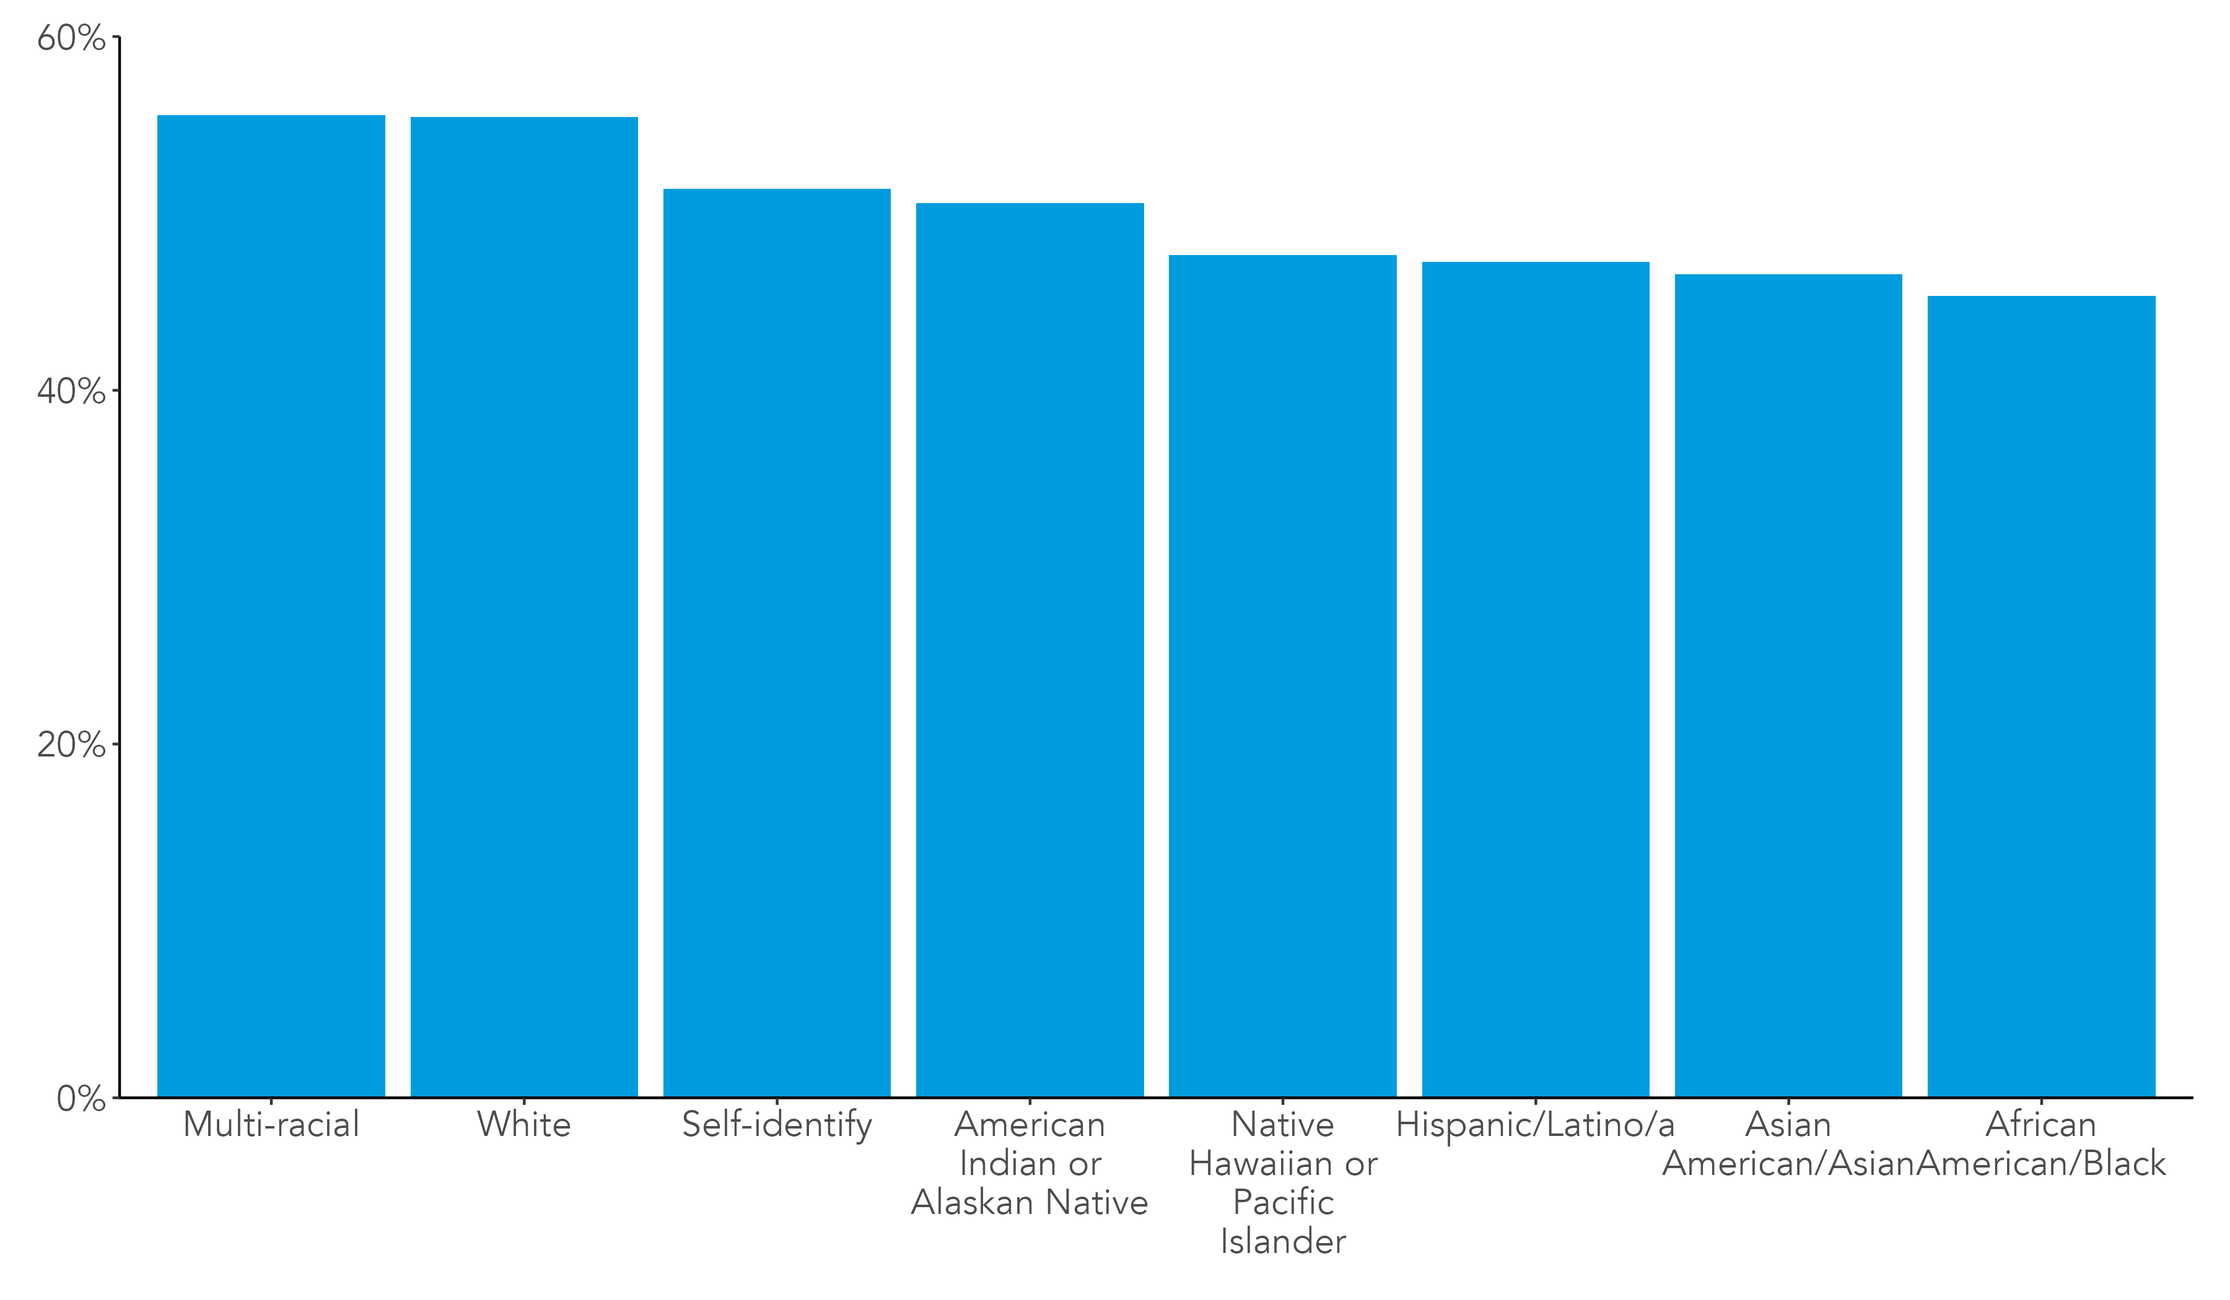
Frequencies of Missed Experiences Due to COVID by Racial Identity (2020-24)
Notes:
Self-Report Data

Slide 27
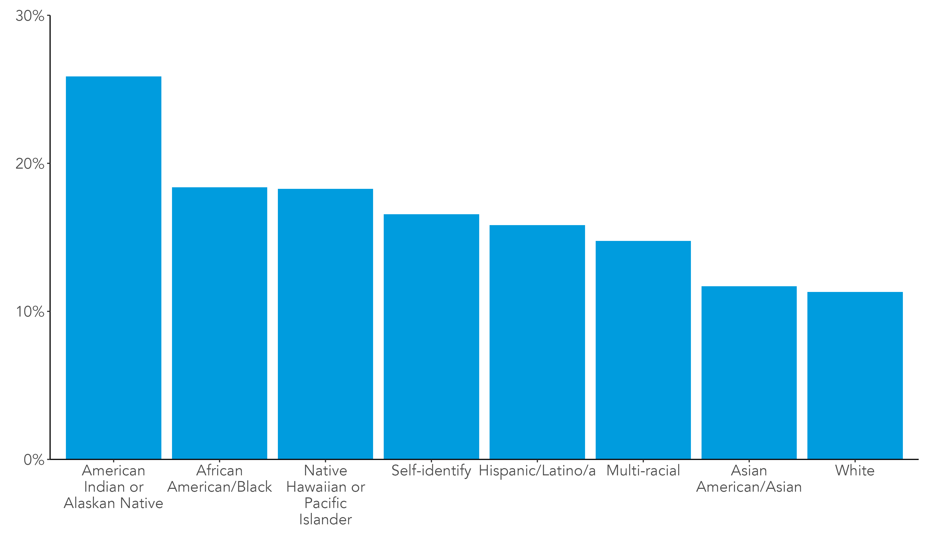
Frequencies of Grief/Loss of Someone Due to COVID by Racial Identity (2020-24)
Notes:
Self-Report Data

Slide 28
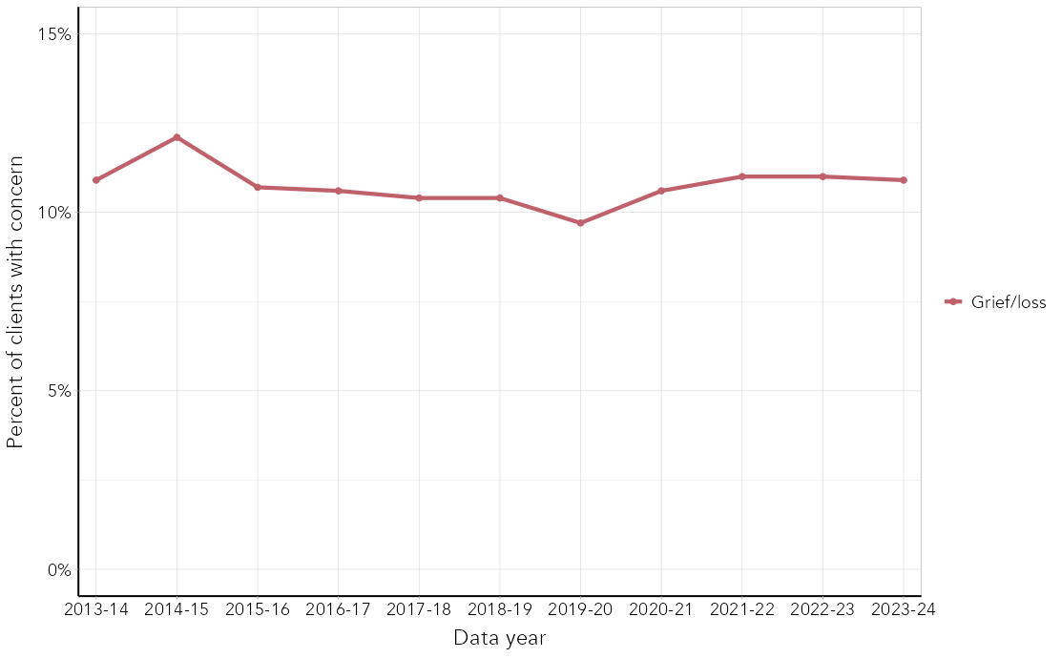
11-Year Trends in Grief/Loss as a Presenting Concern Assessed by Therapists (2013-24)
Notes:
Therapist Assessed (CLICC) – Check All That Apply

Slide 29

What Data are you Utilizing?
Perspective Matters

Slide 30



Process vs. Rumination
Emotions need processed
Feelings are not facts, but they are data
Providing grace while creating structure
Rituals matter
Finish Gestalts when you can

Slide 31

Sturdy and Sustainable
Chapter 5

Slide 32
Nurturing Relationships+
Maintaining Boundaries
Loss of Experience is Universal/Needs Honored

Slide 33

What will I do differently tomorrow?
How might I show up for myself and others who have had a loss of experience?

Slide 34

Thank you for spending your time with us!
Natalie Hernandez • nhd110@psu.edu •

Slide 35







Appendix &
Resources

Slide 36



Resources

